Slide 1


Al rahma medical center
School of Engineering
Department of Computer and Communication
Done by :
Ahmad Nsaif
Ali Aljawad
Supervisor :
Hussein Nasrallah
Committee member:
Ahmad Kobeissi

Slide 2
Outline
Problem Statement & Proposed Solution
Project Overview
Similar Systems
System Design & Implementation
Conclusion & Future work

Slide 3
Problem statement & solutions
The difficulties in coordinating between the patient, doctor and center.
We are implementing digitalization into the center.
Facilitating the communication between the doctor and his patients.

Slide 4
Project overview
The proposed solution for such problem, is using online technology for communication (website).
The patient can book appointments that can appear instantly to the doctor.
The doctor can diagnose his patients using this app.
The admin can post the events done by the center.

Slide 5
Similar systems
Family Clinic
S clinic
Dbayeh Medical Clinic

Slide 6
System design of the website
Case of Patient :
Registration
Booking appointment
Searching for doctors
Case of Doctor :
Confirming or cancelling appointments
Diagnosing Patients
Searching for patients
Case of Admin :
Posting events
Adding Doctors
Viewing Statistics
Searching for patients/drs.

Slide 7
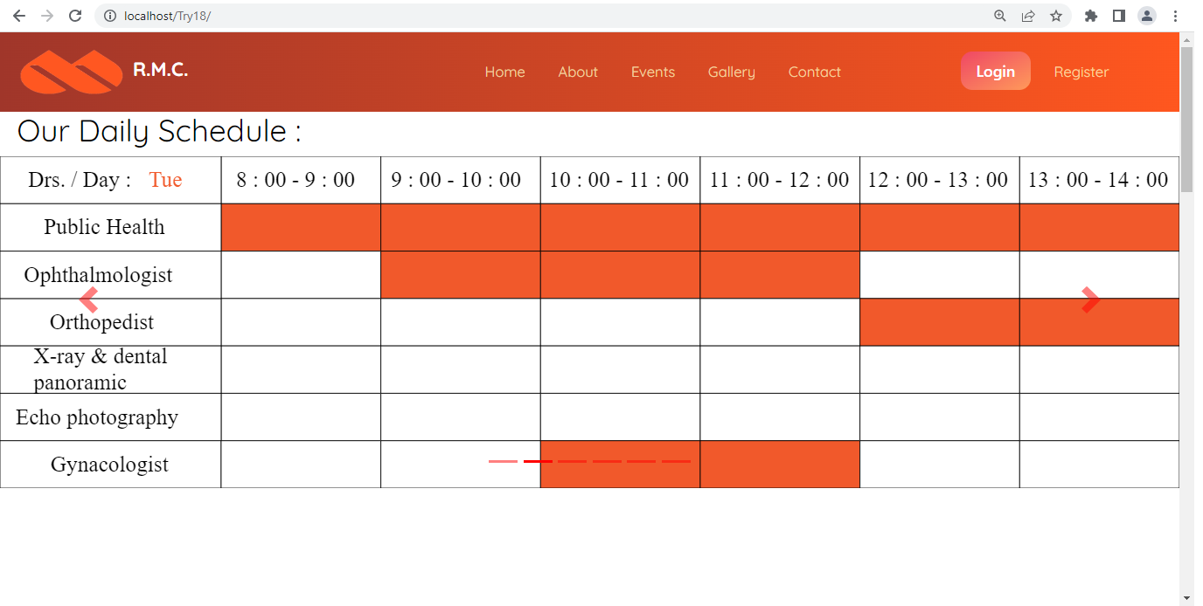
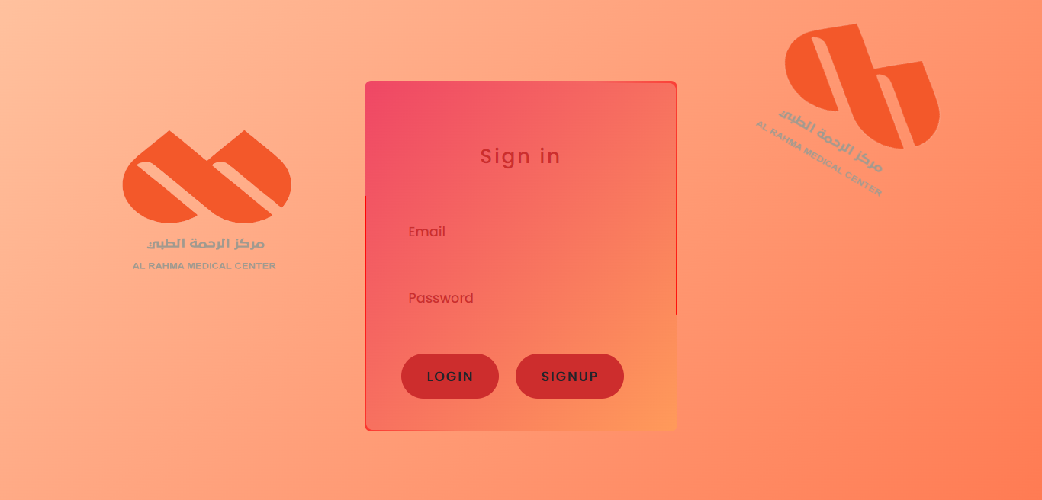
System design of the website

Slide 8
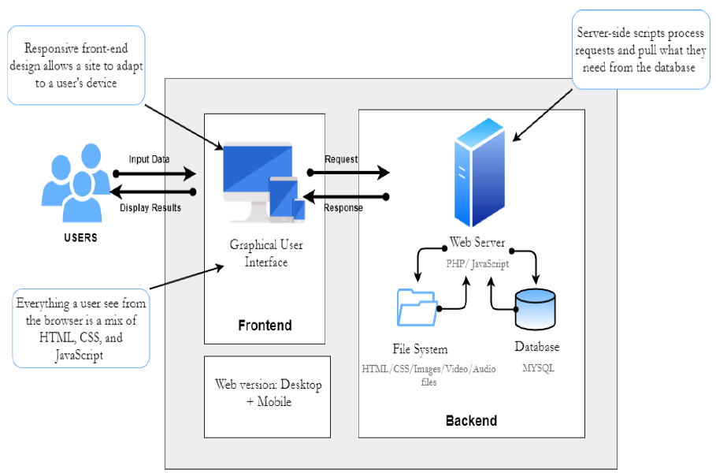
System architecture

Slide 9


implementation

Slide 10
Future work
We have a big chance to activate this demo in real life.
Implementing a chat between the patient and the doctor
Improving the overall design
Adding more options.

Slide 11
Thank you

